Slide 1
EENG 284 Lab 4
Hi Lo Guessing Game
Notes:
Usually the <title of the lab> is what will be called the “System” through the rest of this document

Slide 2
Lab Objectives
Verilog
Generics
LFSR
Using basic building blocks
3:8 decoder
2:1 mux
Compare
Mux
Hex2Seven
Simulation
Use of Do files
Synthesis

Slide 3
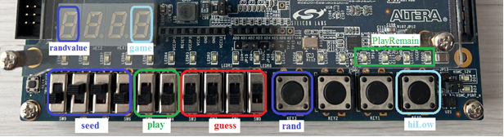
Game Play
Notes:
Replace <System> with the name of the

Slide 4
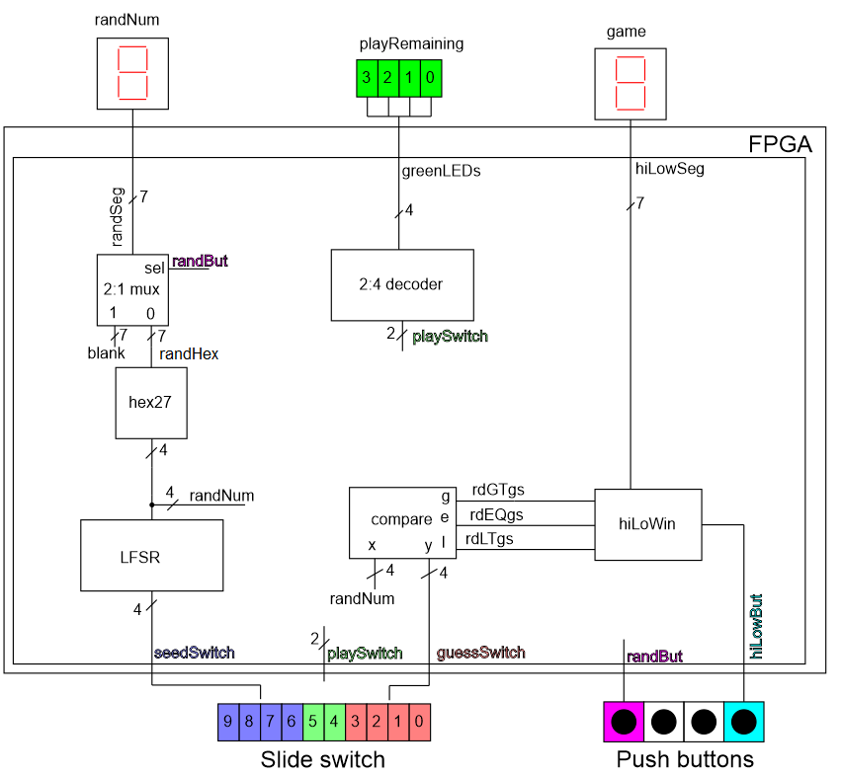
System architecture
Design
Linear Feedback Shift Register
hiLoWin
Instantiate
2:1 mux (provided)
Compare (provided)
2:4 decoder
Hex27 (use lab 2 code)
Notes:
Talk about the input is transformed into the output using the system architecture

Slide 5
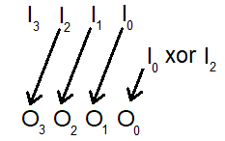
LFSR
Input
4-bit vector seed
Output
4-bit random
Implement
Use 4 assignment statements
Shift using bit indices
Use xor function ^

Slide 6
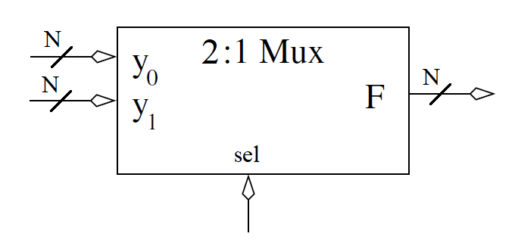
2:1 MUX
Input
2 N-bit vectors
1 bit select
Output
N-bit vector selected
Behavior
Switches the selected input to the output
Provided Code
// Module definition for the 2:1 mux
module genericMux2x1(y1, y0, sel, f);
// Module instantation for a 2:1 mux in the hiLow digital circuit
genericMux2x1 #(7) muxHex( 7 ’ b1111111 , randHex , randBut , randSeg ) ;

Slide 7
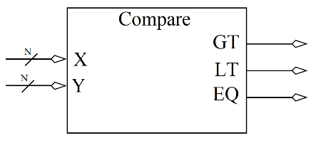
Comparator
Input
2 N-bit vectors
Output
GT = 1 when X > Y
LT = 1 when X < Y
EQ = 1 when X == Y
Behavior
Switches the selected input to the output
Provided Code

Slide 8
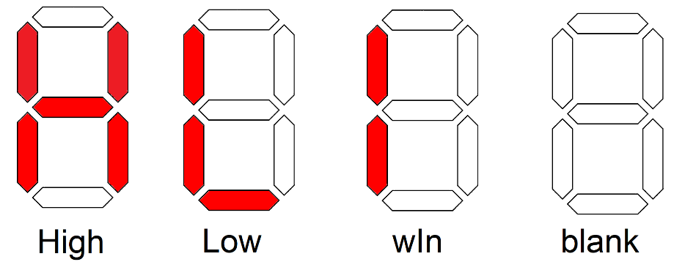
hiLow Win
Input
3-bit ones hot
Output
7-bit segments showing state of play
Implement
Consider always case statement

Slide 9
hiLow Module
Glue together
Module instantiations
Always/case statements for
2:4 decoder
hiLoWin
Reg types for always/case statement
Wire for output from instantiations

Slide 10
Provided Code
Generics
Generics allow you to specify the width of input signal
2:1 Mux
Comparator
Testbench
hiLow
// Module definition for the 2:1 mux
module genericMux2x1(y1, y0, sel, f);
// Module instantation for a 2:1 mux in the hiLow digital circuit
genericMux2x1 #(7) muxHex( 7 ’ b1111111 , randHex , randBut , randSeg); ;

Slide 11
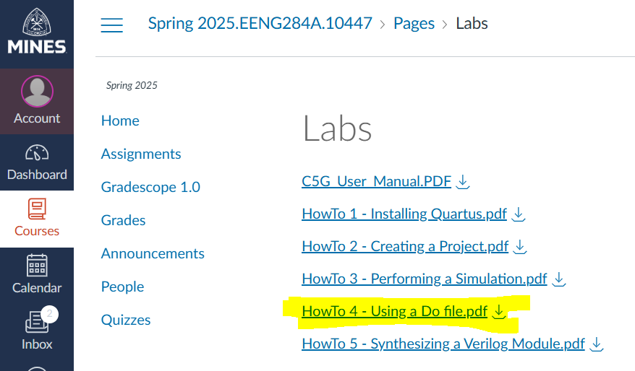
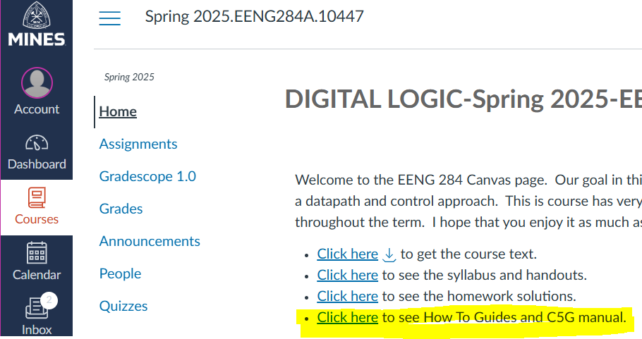
Do File
Do file
Automates adding signals to timing diagram
On home page, click How To Guides

Slide 12
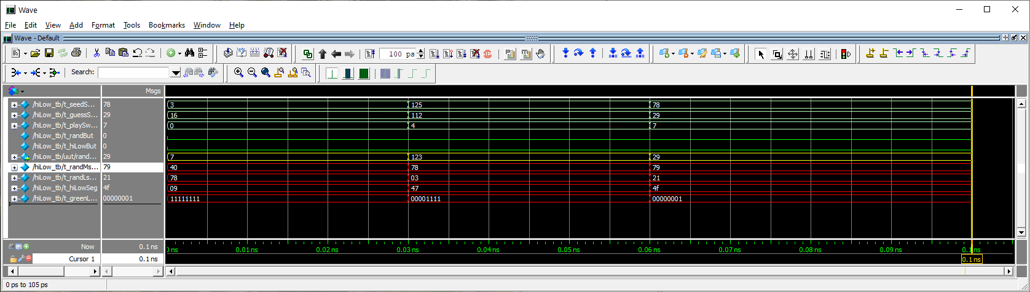
Deliverables
LFSR code and testbench for LFSR
Pin assignment
hiLow Testbench output
Working hiLow implementation on Cyclone V GX boards

